Slide 1
AngularJS
Opening
John Zhou
2016.06.21

Slide 2
Agenda
1
Browser
2
History
3
Library & Framework
4
Tag & Script

Slide 3
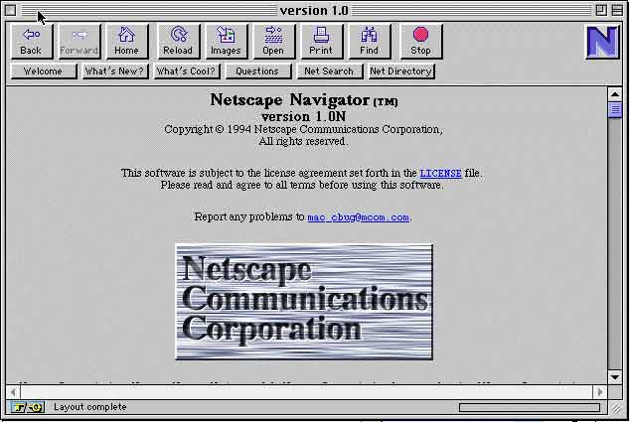
1
Browser
Netscape Navigator – 1994
All actions in server(C/S)

Slide 4
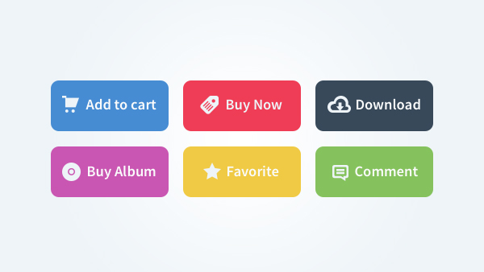

2
History - HTML
Standard Generalized Markup language – SGML
Extensible Markup Language – XML
HyperText Markup Language – HTML
Flattening
CSS

Slide 5
2
History - JavaScript
We need a script!!!
Perl,Python,Tcl,Scheme
A new language?
Java came out
Write Once, Run Anywhere
Netscape + Java -> Java + script
JavaScript
1995/5 Design is finalized
1995/10 Interpreter complete
1995/12 marketed(explosive growth)
1996/8 Jscript from Microsoft
1997/6 ECMA-262(1.5 years after! 20 years for C)
Notes:
https://ironjs.wordpress.com/2011/06/22/my-gripes-with-javascript/
http://www.ruanyifeng.com/blog/2011/06/10_design_defects_in_javascript.html

Slide 6
2
History - JavaScript
JavaScript design flaws
http://www.programering.com/a/MDN5cDNwATM.html
http://www.ruanyifeng.com/blog/2011/06/10_design_defects_in_javascript.html

Slide 7
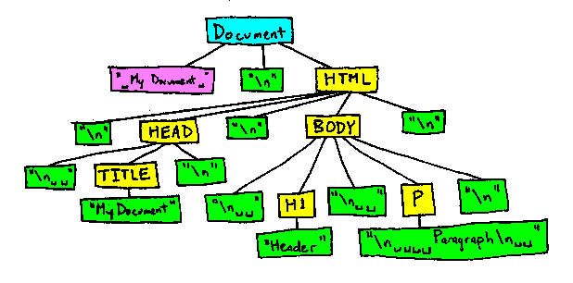
3
Library & Framework
jQuery
HTML dom tree
cross-browser
DOM Manipulation simply

Slide 8
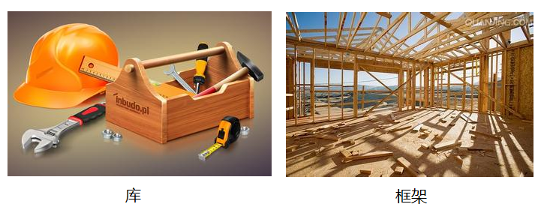
3
Library & Framework
jQuery is enough?
AngularJs
Declarative interface development
Two-way data binding
Dependency injection

Slide 9
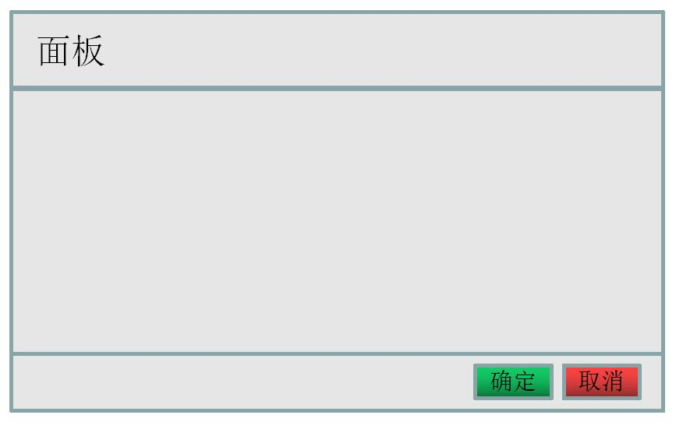
4
Tag & Script
A simple requirement
Alert “Confirm” or “Cancel”

Slide 10
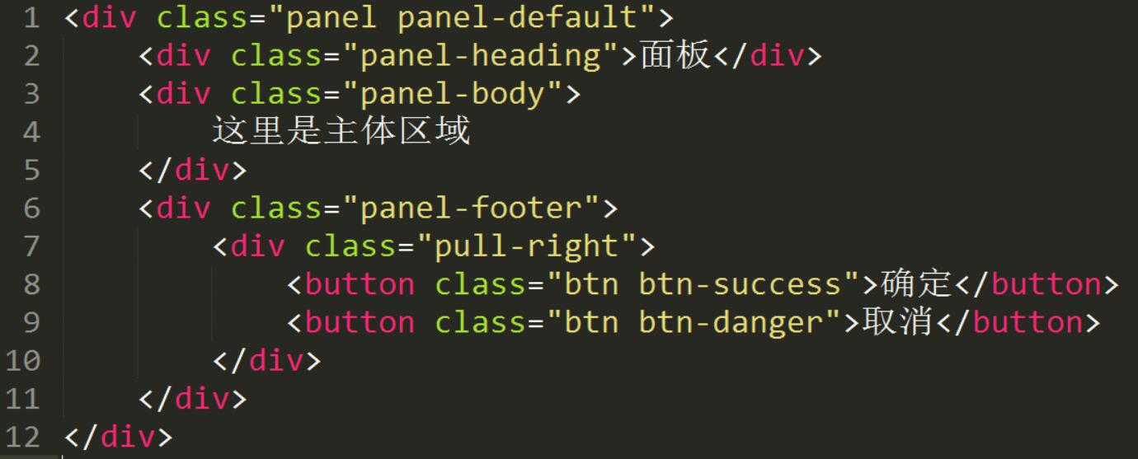
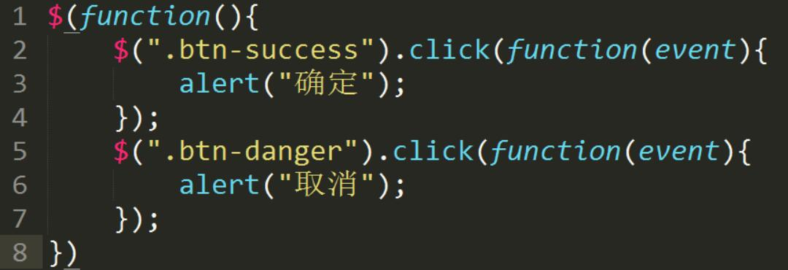
4
Tag & Script
jQuery

Slide 11
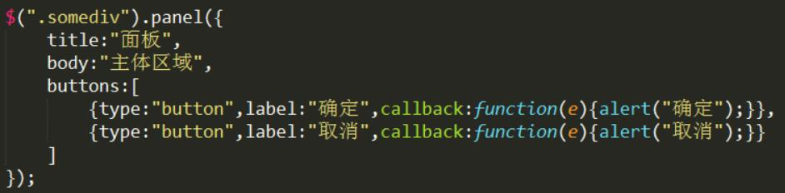
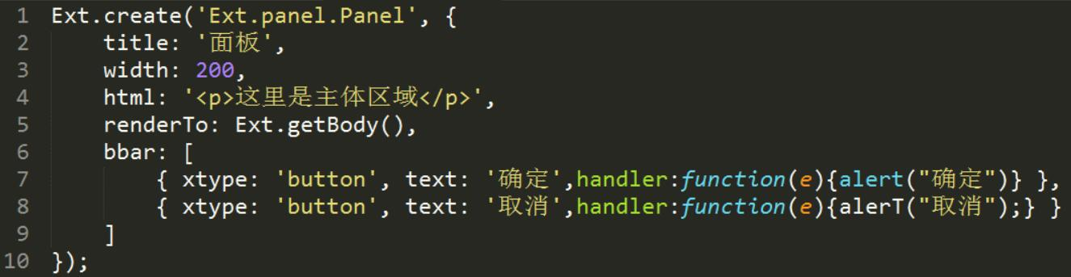
4
Tag & Script
jQueryUI
Extjs

Slide 12
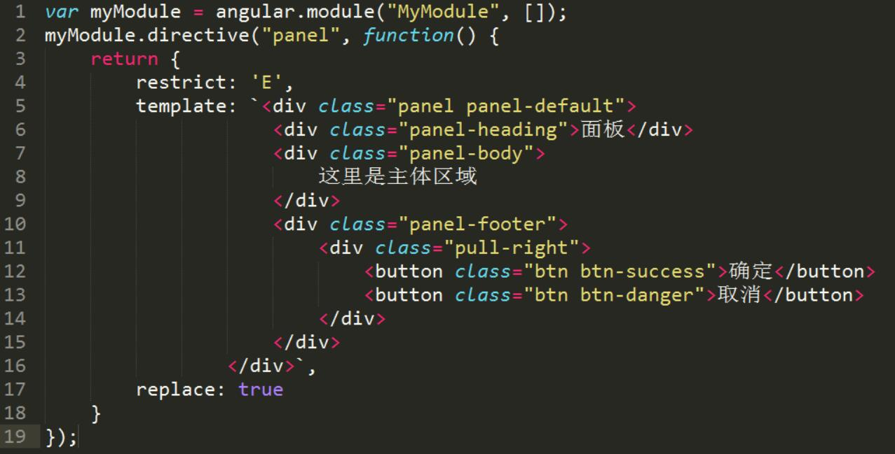
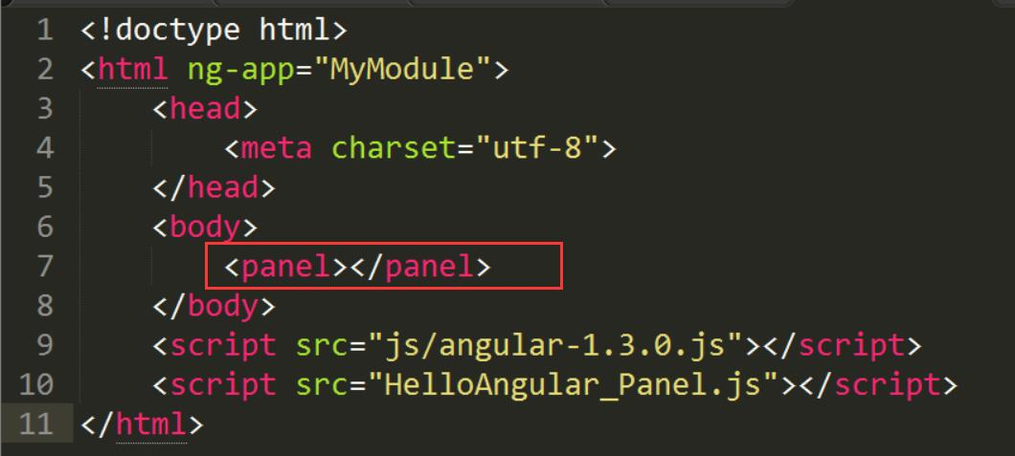
4
Tag & Script
AngularJs

Slide 13
4
Tag & Script
Tag (WebCoponent)
Angularjs/React/Flex
Script
jQuery UI/Extjs
Scattered Tag & JS
All packaging in JS
All Tags less JS
Is seldom used now
jQuery/Extjs
AngularJs/React/Flex
(WebComponent)

Slide 14
4
Tag & Script
jQueryUI & Extjs
Defined component as a object.
How about that
<panel ...>...</panel>?

